Slide 1

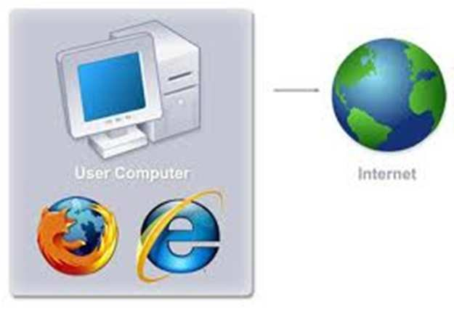
COM 210
Structured Programming
Kariuki Paul
memekariuki@gmail.com

Slide 2
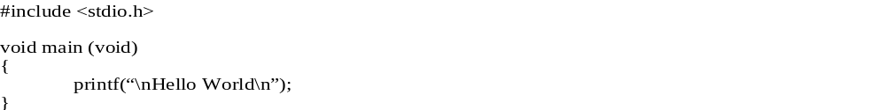
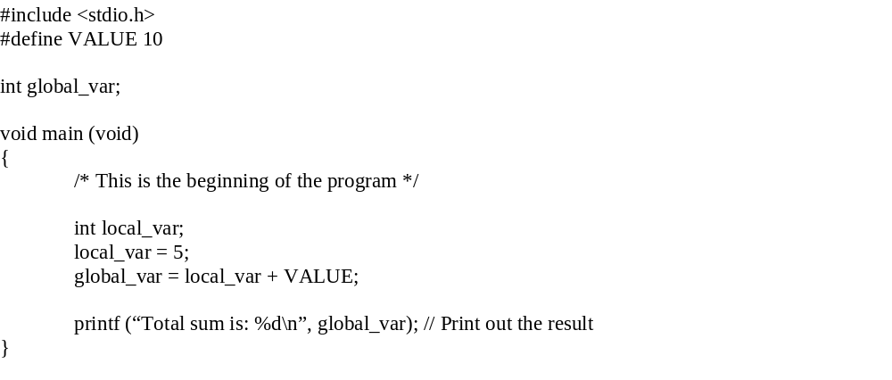
Structure of a C program
Preprocessor directive (header file)
Program statement
}
Preprocessor directive
Global variable declaration
Comments
Local variable declaration
Variable definition

Slide 3
Comments
Explanations or annotations that are included in a program for documentation and clarification purpose.
Completely ignored by the compiler during compilation and have no effect on program execution.
Starts with ‘/*’ and ends with ‘*/’
Some compiler support comments starting with ‘//’

Slide 4
Preprocessor Directives
The first thing to be checked by the compiler.
Starts with ‘#’.
Tell the compiler about specific options that it needs to be aware of during compilation.
There are a few compiler directives. But only 2 of them will be discussed here.
  #include <stdio.h>
    Tell the compiler to include the file stdio.h during compilation
    Anything in the header file is considered a part of the program
  #define VALUE 10
    Tell the compiler to substitute the word VALUE with 10 during compilation

Slide 5
Preprocessor Directives
#define PI 3.141592654
main() {
…..
perimeter = 2*PI*radius;
area = PI*radius*radius;
…...
}
The result of the compilation is the same for both program.
Which one is preferred (less typing)?
Which more readable? The one with awful long series of digits the one with a meaningful name?
Before compilation, the pre-processor will replace all PI with 3.141592654.
main() {
…..
perimeter = 2* 3.141592654 *radius;
area = 3.141592654 *radius*radius;
…...
}

Slide 6
Basic Data Types
3 examples of basic data types:
  int (used to declare numeric program variables of integer type)
  char (used to declare character variable)
  double (used to declare floating point variable)
In addition, there are float, void, short, long, etc.
Declaration: specifies the type of a variable.
  Example: int local_var;
Definition: assigning a value to the declared variable.
  Example: local_var = 5;

Slide 7
A variable can be declared globally or locally.
A globally declared variable can be accessed from all parts of the program.
A locally declared variable can only be accessed from inside the function in which the variable is declared.

Slide 8
Statements
A specification of an action to be taken by the computer as the program executes.
In the previous example, there are 2 lines following variable declaration and variable definition that terminate with semicolon ‘;’.
  global_var = local_var + VALUE;
  printf (“Total sum is: %d\n”, global_var);
Each line is a statement.

Slide 9
Basic Functions
A C program consists of one or more functions that contain a group of statements which perform a specific task.
A C program must at least have one function: the function main.
We can create our own function or use the functions that has been created in the library, in which case we have to include the appropriate header file (example: stdio.h).

Slide 10
In this section, we will learn a few functions that are pre-defined in the header file stdio.h
These functions are:
  printf()
  scanf()
  getchar() & putchar()
In addition to those functions, we will also learn about Format Specifier and Escape Sequence which are used with printf() and scanf().

Slide 11
printf()
Used to send data to the standard output (usually the monitor) to be printed according to specific format.
General format:
  printf(“control string”, variables);
Control string is a combination of text, format specifier and escape sequence.
Example:
  printf(“Thank you”);
  printf (“Total sum is: %d\n”, global_var);
    %d is a format specifier
    \n is an escape sequence

Slide 12
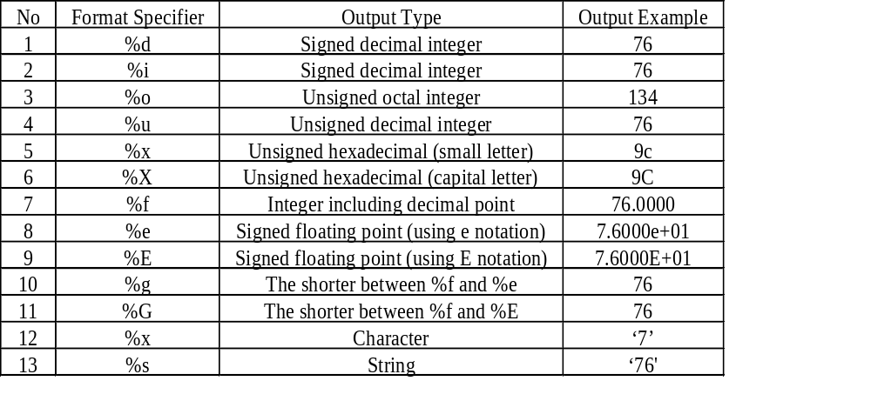
Conversion/Format specifier
Tells the printf() function the format of the output to be printed put.

Slide 13
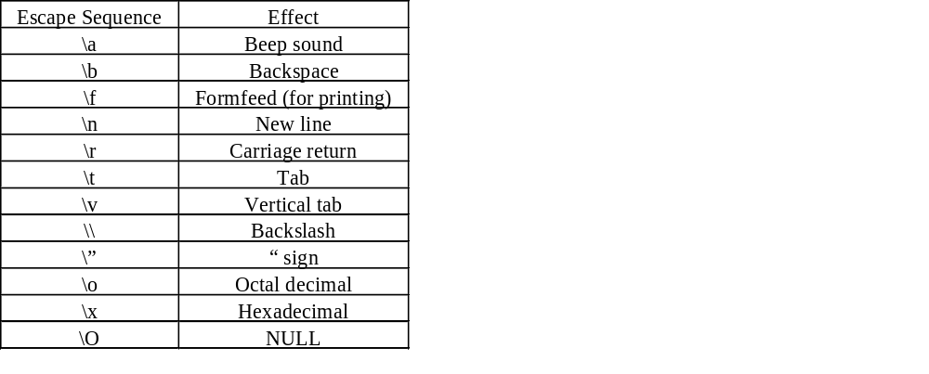
Escape Sequence
Escape sequence is used in the printf() function to do something to
the output.

Slide 14
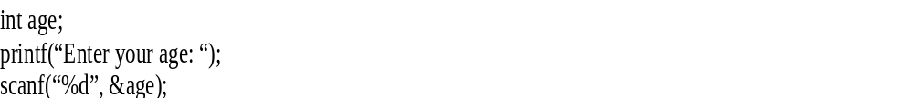
scanf()
Read data from the standard input device (usually keyboard) and store it in a variable.
General format:
  scanf(“Control string”, &variable);
The general format is pretty much the same as printf() except that it passes the address of the variable (notice the & sign) instead of the variable itself to the second function argument.
Example:

Slide 15
getchar() and putchar()
getchar() - read a character from standard input
putchar() - write a character to standard output
Example:
#include <stdio.h>
void main(void)
{
char my_char;
printf(“Please type a character: “);
my_char = getchar();
printf(“\nYou have typed this character: “);
putchar(my_char);
}

